Slide 1
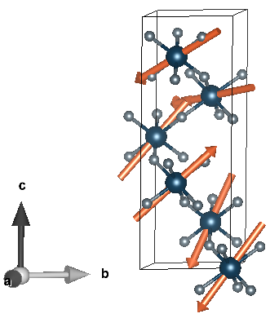
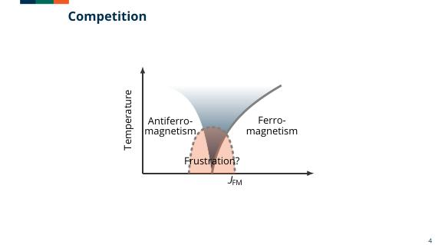
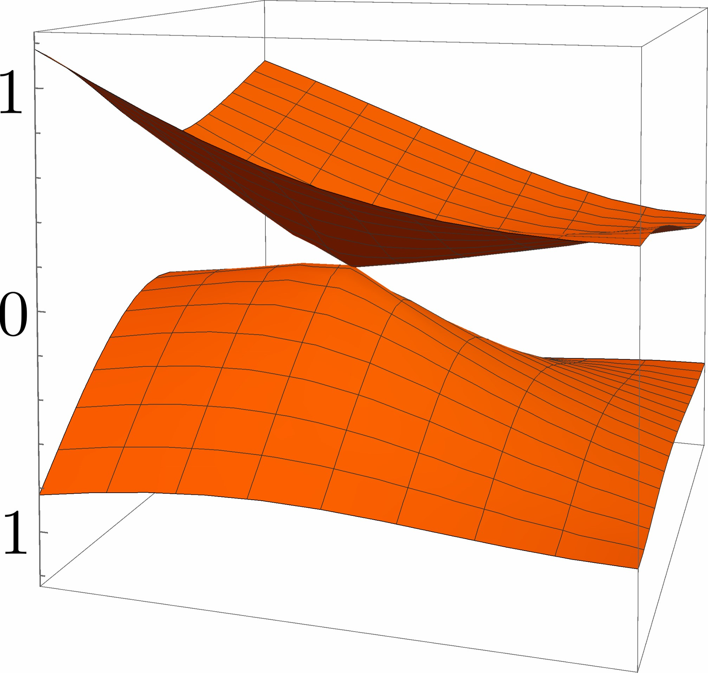
Condensed Matter Theory ---------------------------------------------------------------- Gayanath Fernando with other collaborators:
Floquet-Bloch systems
Periodically Driven Quantum Systems / Effective Hamiltonian
AC-Driven D-dimensional Lattice
Time Evolution for Different Driving Regimes
Rare-earth magnetism
Magnetic frustrations: Spin Liquids
Organic and Dirac Materials
Hatsugai-Kohmoto Model – interactions in k-space
Foundations of Quantum Mechanics

Slide 2
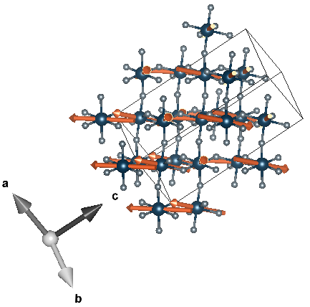
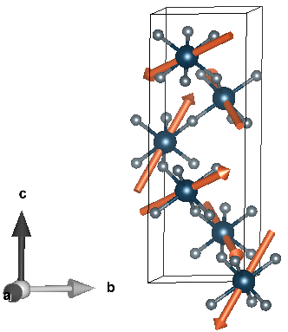
Possible spin liquid?
TiF₃
U = 2 eV (metallic)
Calculated Magnetization
Experimental collaborators:
Jason Hancock et al.

Slide 3
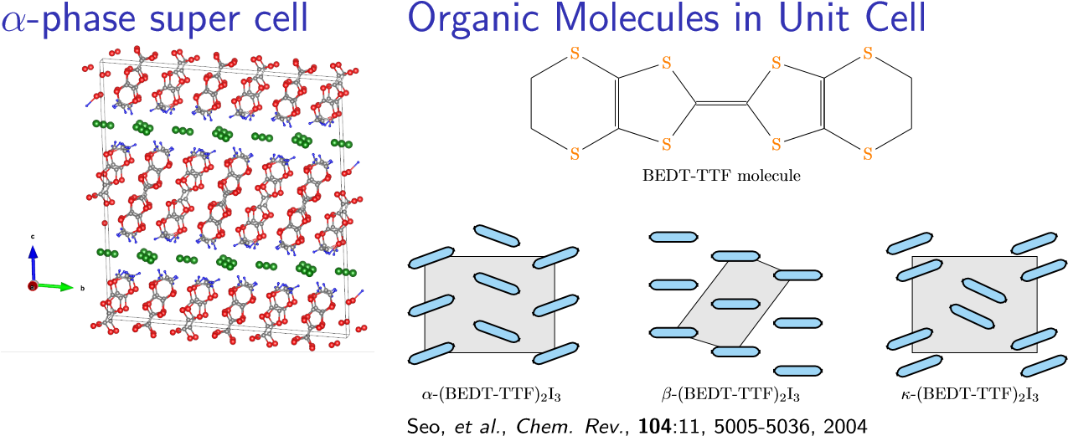
Quasi 2D Organics (BEDT-TTF)₂X
Different Phases, α, β, κ, ..
PRB 96, 125135 (2017)
PSS-RRL, 1800081 (2018)
Anions - X
Donors – (BEDT-TTF)
Other: Quasi 1D (TMTSF)₂X

Slide 4
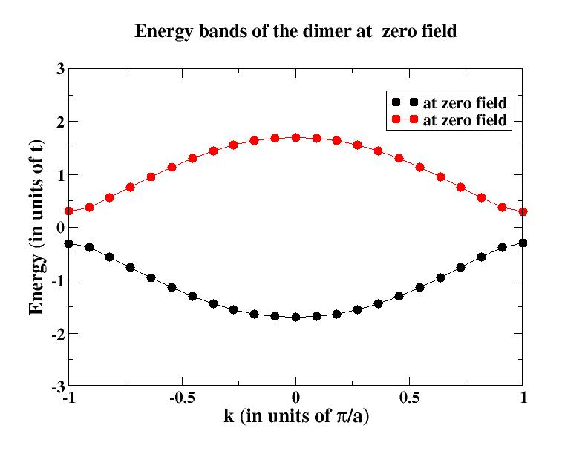
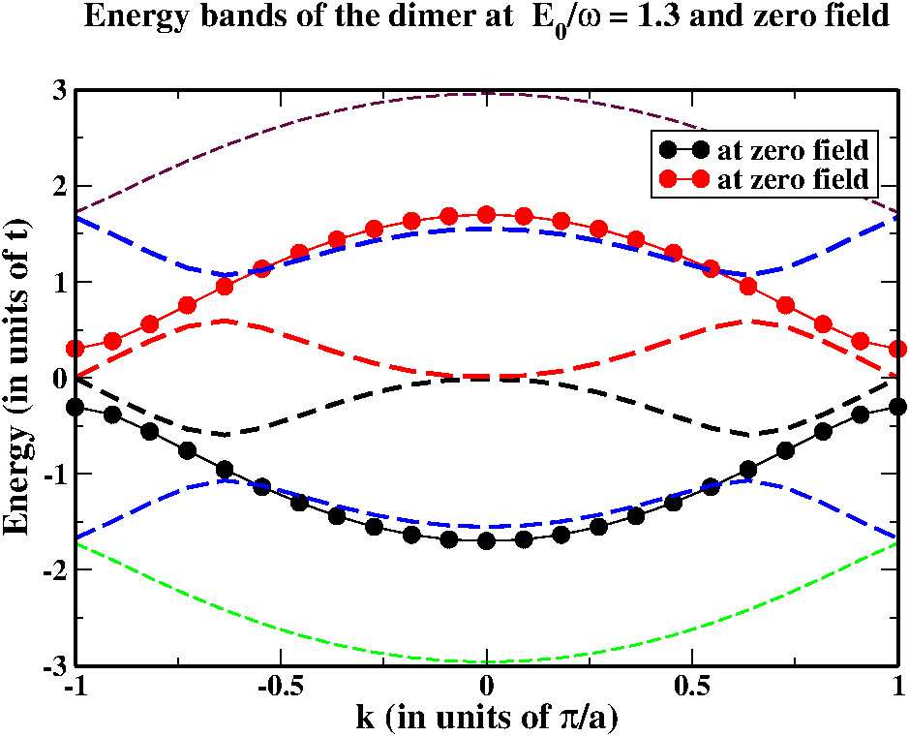
Analogue to a (D+1)-dimensional Lattice --- Gomez-Leon and Platero, PRL 110, 200403 (2013)
Periodic Dimer Chain and Peierls Gap
Closing of the Peierls Gap at the zone edges due
to Floquet bands at specific field/frequency values
Coupling of Floquet bands depends on the driving regime
Bloch band splits into copies of Floquet-Bloch bands
EPL, Vol. 134, 37004 (2022)
H( r + R_{i} , t + T) = H( r + R_{i} , t ) = H( r , t + T ) = H ( r , t );
period of the driver T = 2π$/$ω and R_{i} s are lattice vectors

