Slide 1
Simone Colombo, PhD
Assistant Professor, Physics, UCONN

Slide 2
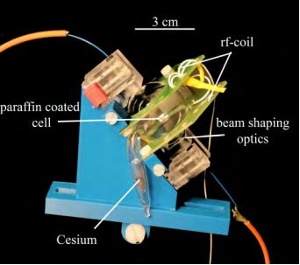
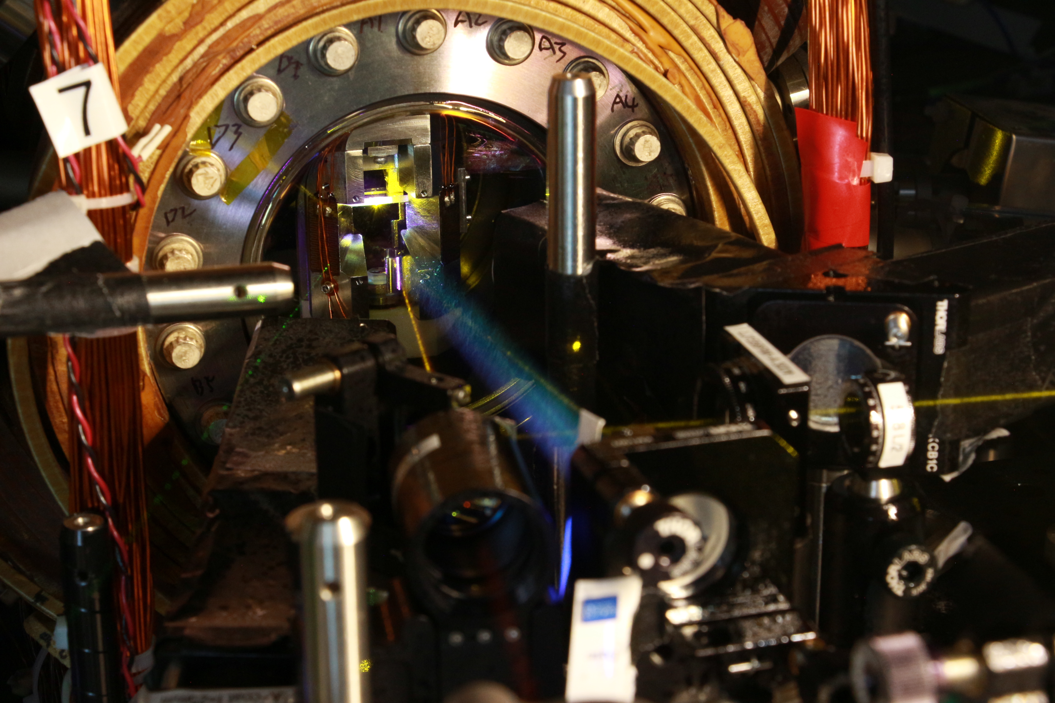
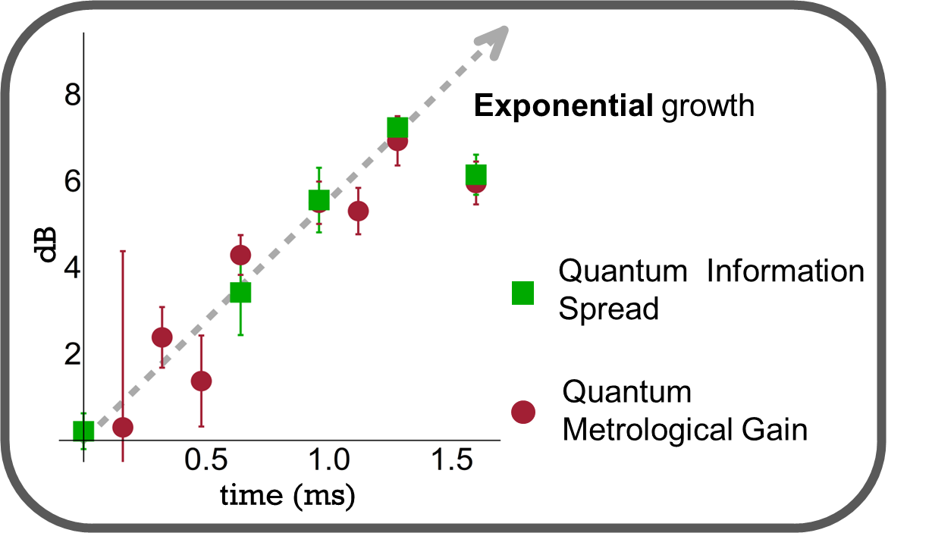
What Excites me about Quantum Technologies
Scientific Vision : harnessing many-body quantum systems for applications spanning from quantum sensing to quantum simulation and information
Quantum Superposition and Entanglement
(Trying to) Understand the fundaments of Quantum Mechanics
Use Quantum effects to our advantage
Gaining control of “quantum objects”
Sensors
Quantum Simulators
Colombo, S. (2017)
A magnetic particle imaging scanner based on atomic magnetometry
Li, Z., Colombo, S., et al. Science 380 (6652), 1381-1384

Slide 3
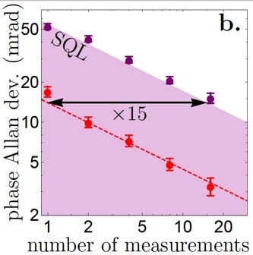
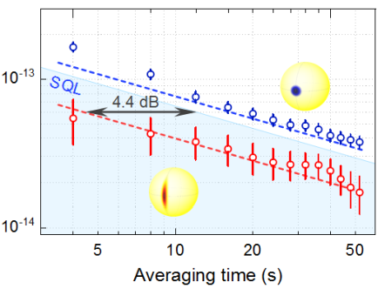
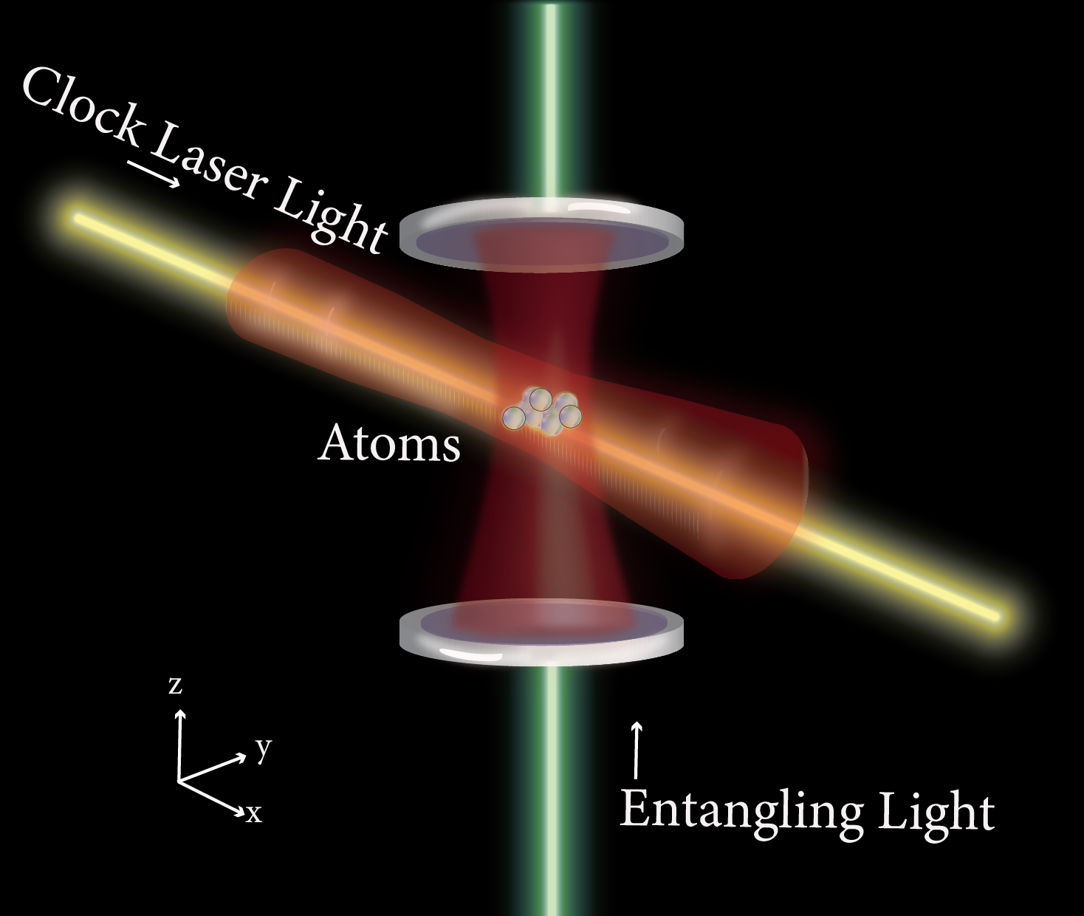
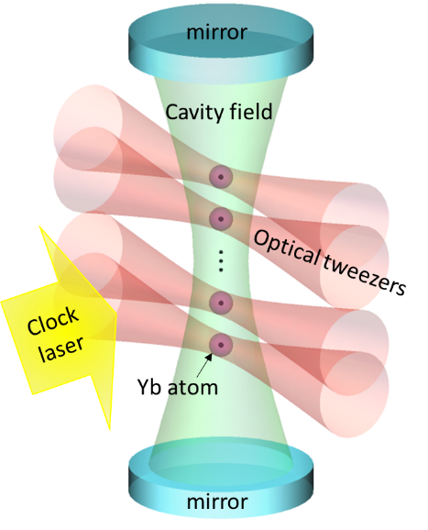
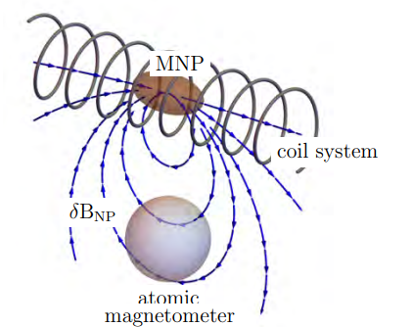
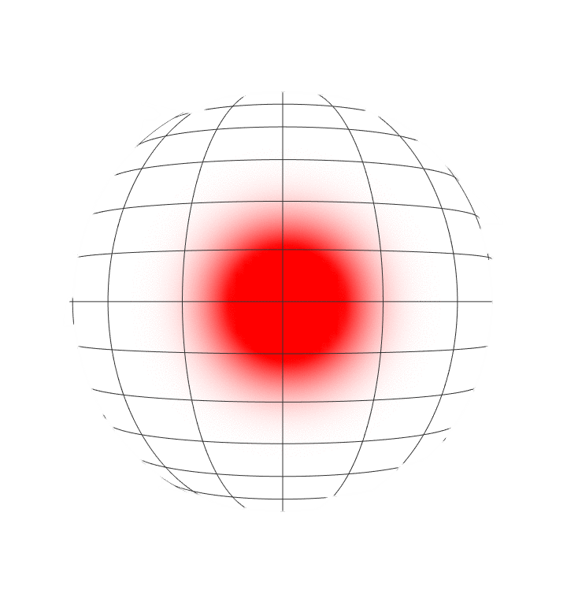
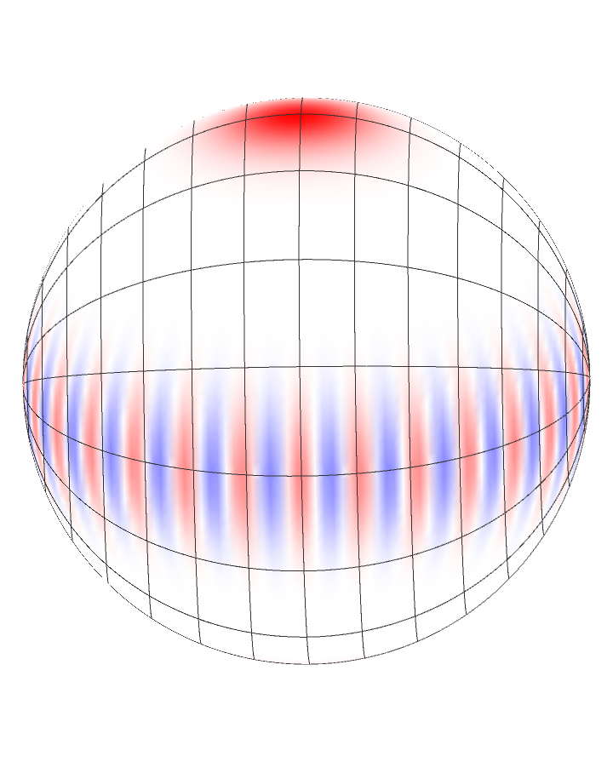
Expertise and Core Strengths
Scientific Vision : harnessing many-body quantum systems for applications spanning from quantum sensing to quantum simulation and information
Experimental Atomic, Molecular, and Optical (AMO) Physics; Quantum Information Science and Metrology.
Colombo S. (2017)
Atomic magnetometry
Quantum-Enhanced Sensors
Optical atomic clocks
Cavity QED
Quantum Information Science
Source
Colombo, S. (2017) A magnetic particle imaging scanner based on atomic magnetometry

Slide 4
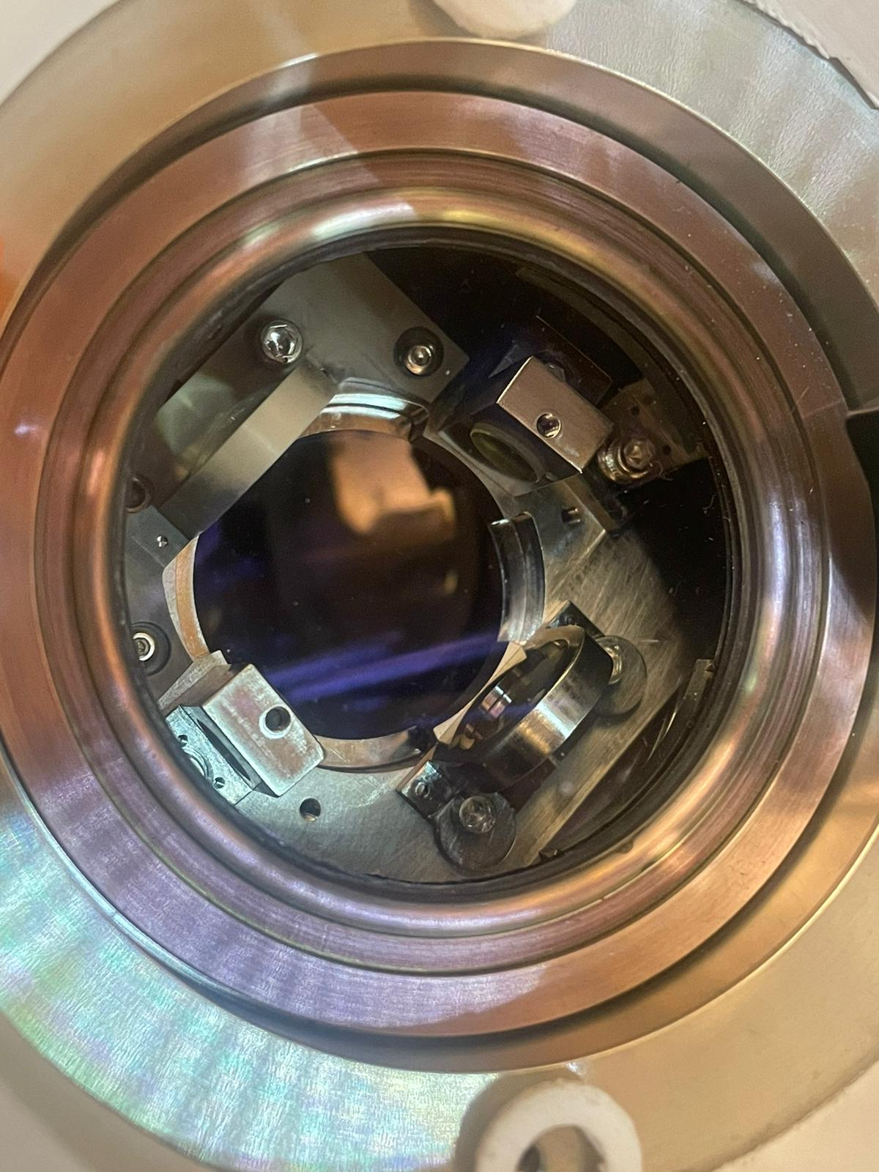
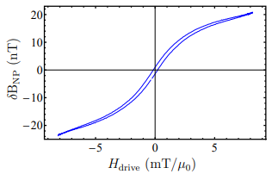
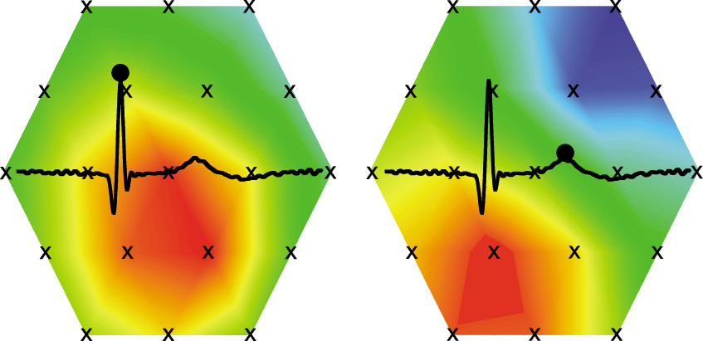
Collaboration Ideas (unilateral)
Cavity QED for enhanced detection of atoms and molecules. CQED for cooling...
(Daniel McCarron, Chemistry, ...)
Quantum Many-body systems and Q Simulation (OTOC, Chaotic systems,...)
(Lea Santos, Pavel Volkov, Sasha Balatsky, ... )
Colombo, S., et al., IJMPI 2, 1, (2016)
G. Bison, et al. Appl. Phys. Lett. 95, 173701 (2009)
Applications of atomic magnetometry, and other quantum sensor
(complementary to Ilya Sochnikov, Chemistry Dept., Biomed, Materials, ... )
Instructional/teaching, Quantum Technology curriculum
(See Jason Hankock )
American Journal of Physics 76 (2), 137-142.

